Slide 1

C++
Basic Object Oriented Programming

Slide 2
Table of contents Index / Agenda
Classes and class members
Encapsulation
Constructor/Destructor
Copy constructor
This pointer
Assignment operator
Shallow copy vs Deep copy
Friend Function
Overloading operators
Hiding the implementation
References
Author

Slide 3
Classes and class members
Class
User-defined type
Represents a “blue-print of an object” (a template to create an object).
Contains data members and function members
Object
Is a variables of the class (instance of the class)

Slide 4
Classes and class members
using namespace std;
class Student
{
// access specifier
public:
// data members
int _nota;
string _numeStudent;
// method - function member
void Display()
{
cout << _numeStudent
<< " nota " << _nota;
}
};
int main()
{
int i;
// Student - data type, "popescu" - variable name
// "popescu" - is an instance of Student
// - is an object of type Student
Student popescu;
// Access and modify the data member
popescu._numeStudent = "Popescu";
popescu._nota = 9;
// Call display function;
popescu.Display();
return 0;
}

Slide 5
Classes and class members
Access specifiers
Public members are members of a class that can be accessed by any function in the program. – visible anywhere
Private members are members of a class that can only be accessed by other functions within the class – visible only to methods of own type
Protected members are member of a class acts just like private, with one exception: “Inherited” structures(which cannot access private members) are granted access to protected members.

Slide 6
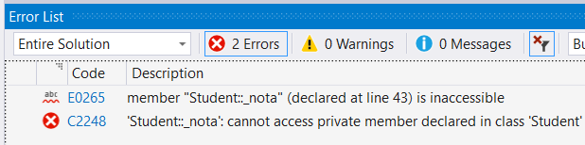
Classes and class members
class Student
{
private: // access specifier
int _nota; // private data member
public: // access specifier
string _numeStudent; // public data
void Display() // public method
{
// Correct, _nota can be accessed
// only inside the class
cout << _numeStudent
<< " nota " << _nota;
}
};
int main()
{
// Declare a variable of type Student
Student popescu;
// Correct, _numeStudent is public
popescu._numeStudent = "Popescu";
// Compiler error _nota is private
popescu._nota = 9;
// Correct, Display is public
popescu.Display();
return 0;
}

Slide 7
Encapsulation
Is an Object Oriented Programming concept that binds together the data and functions that manipulate the data, and that keeps both safe from outside interference and misuse.
Is a mechanism of bundling the data, and the functions that use them and data abstraction is a mechanism of exposing only the interfaces and hiding the implementation details from the user.
Is typically done by making ALL member variables of a class private, and providing public functions (often access functions) that allow the user to work with the class.

Slide 8
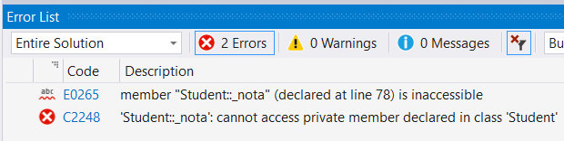
Encapsulation
class Student
{
private:
int _nota;
string _numeStudent;
public:
void SetNota(int nota) // setter - mobifies _nota
{
_nota = nota;
}
int GetNota() // getter - returns _nota
{
return _nota;
}
//...
};
int main()
{
Student popescu;
// modify _nota value
popescu.SetNota(9);
// read _nota value
cout << popescu.GetNota() << " ";
// Compiler error. Can you tell why?
popescu._nota = 8;
return 0;
}

Slide 9
Constructor
Is a special kind of class member function that is executed when an object of that class is instantiated. Constructors are typically used to initialize member variables of the class to appropriate default values, or to allow the user to easily initialize those member variables to whatever values are desired.
Constructors must always have the same name as the class (with the same capitalization)
Constructors have no return type (not even void)

Slide 10
Default constructor
A default constructor is a constructor than can be called without no arguments
If no user-defined constructors of any kind are provided for a class type (struct, class, or union), the compiler will always declare a default constructor as an inline public member of its class.
If some user-defined constructors are present, the user may still force the generation of the implicitly declared constructor with the keyword default.
Inhibit the generation of default constructor with the keyword delete.

Slide 11
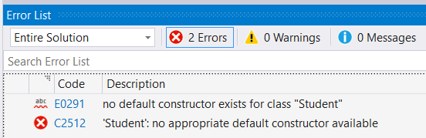
Constructor - Examples
If no user defined CTOR exists, the compiler generates a default CTOR
If the user defines a CTOR , the compiler doesn’t generate another, see error message for details
Constructor overloading - compiler will call the one whose parameters match the arguments used in the function call
class Student
{
public:
// No CTOR declared
// ...
};
int main()
{
// Call default CTOR.
Student popescu;
return 0;
}
class Student
{
public:
Student(int){}
};
int main()
{
// Compiler error. Why?
Student popescu;
return 0;
}
class Student
{
int _nota;
public:
Student(){}
Student(int){}
// ...
};
int main()
{
// Call default CTOR
Student popescu;
// Call overloaded, int CTOR
Student ionescu(9);
return 0;
}

Slide 12
Destructor
A destructor is a special member function that is called when the lifetime of an object ends. The purpose of the destructor is to free the resources that the object may have acquired during its lifetime.
If no user-defined destructor is provided for a class type (struct, class, or union), the compiler will always declare a destructor as an inline public member of its class.
The destructor must have the same name as the class, preceded by a tilde (~).
The destructor can not take arguments.
The destructor has no return type.
Example, user defined DTOR
class Student
{
public:
~Student(){} // Destructor
};
int main()
{
// Call default CTOR
Student popescu;
return 0;
}
// When ‘Student’ object goes out of
// scope, destructor is called.

Slide 13
Copy constructor
Is a special constructor that initializes a new object from an existing object.
C++ will provide a default copy constructor if you do not provide one yourself.
The copy constructor is called when:
instantiating one object and initializing it with values from another object
passing an object by value
an object is returned from a function by value

Slide 14
Copy constructor - Examples
class Student
{
private:
int _nota;
string _numeStudent;
public:
Student(){}
Student(const Student &source) // copy constructor
{
cout << "Copy constructor\n";
_nota = source._nota;
_numeStudent = source._numeStudent;
}
};
Student CopyFunction(Student source)
{
return source;
}
int main()
{
Student popescu;
// Call copy CTOR
Student ionescu = popescu;
// The copy CTOR is called twice
CopyFunction(popescu);
return 0;
}

Slide 15
This pointer
Is a hidden pointer inside every class member function that points to the class object the member function is working with
Student(int _nota, string _numeStudent)
{
this->_nota = _nota;
this->_numeStudent = _numeStudent;
}

Slide 16
Assignment operator
Assigns to the right hand value of the “=“ operator the left hand value
// Operator =
Student& operator=(const Student &source)
{
_nota = source._nota;
_numeStudent = source._numeStudent;
return *this; // returns an existing object
}

Slide 17
Shallow copy vs Deep copy - theory
Shallow copy - copies all of the member field values of the object
Problems appear when you want to copy fields that point to dynamically allocated memory:
The pointer is copied but the memory it points to will not be copied.
The field in both the original object and the copied object points to the same dynamically allocated memory.
The default copy constructor and assignment operator make shallow copies.
Deep copy - copies all fields, and makes copies of dynamically allocated memory pointed to by the fields.
To make a deep copy, you must write a copy constructor and overload the assignment operator

Slide 18
Shallow copy vs Deep copy - example
Shallow copy – no need to define copy constructor or assignment operator
Deep copy – must define copy constructor and assignment operator
class ShallowCopy
{
private:
int myInt;
char myChar;
public:
ShallowCopy()
{
myInt = 0;
myChar = 0;
}
};
class DeepCopy
{
private:
char* myData;
size_t dataSize;
public:
DeepCopy(size_t size, char* data)
{
this->dataSize = size;
this->myData = new char(size);
std::copy(myData, data+size, this->myData);
}
};
int main()
{
size_t i = 1;
char data = 'a';
ShallowCopy exampleA;
DeepCopy exampleB(i, &data);
return 0;
}

Slide 19
Deep copy – copy constructor
DeepCopy(const DeepCopy& source)
{
dataSize = source.dataSize;
myData = new char(dataSize);
std::copy(source.myData, source.myData + dataSize, myData);
}

Slide 20
Deep copy – assign operator
DeepCopy& operator = (const DeepCopy& source)
{
dataSize = source.dataSize;
delete[] myData;
myData = new char(dataSize);
std::copy(source.myData, source.myData + dataSize, myData);
}

Slide 21
Classes - Friend function
Is a function that can access the private members of a class as though it were a member of that class.
In all other regards, the friend function is just like a normal function.
A friend function may or may not be a member of another class.
To declare a friend function, simply use the friend keyword in front of the prototype of the function you wish to be a friend of the class.
It does not matter whether you declare the friend function in the private or public section of the class.

Slide 22
Classes - Friend function example
Prototype:
class DeepCopy
{
private:
char* myData;
size_t dataSize;
friend void EvilFriendFunction(DeepCopy& source);
// ...
Implementation:
void EvilFriendFunction(DeepCopy& source)
{
source.dataSize = 0;
}

Slide 23
Overloading operators
Overloading <<
You can overload an operator as a friend function or as a member function
class Point
{
private:
double X, Y, Z;
public:
ostream& operator<< (ostream &out)
{
out << "(" << X << ", "
<< Y << ", "
<< Z << ")";
return out;
}
};

Slide 24
Hiding the implementation – headers and sources
point.h:
point.cpp:
#pragma once
#include <iostream>
using namespace std;
class Point
{
private:
double X, Y, Z;
public:
// Forward declarations
Point(){};
Point(double x, double y, double z);
ostream& operator<< (ostream &out);
};
#include "Point.h"
// :: scope resolution operator specifies that the operator '<<'
// is a member of Point
ostream& Point::operator<< (ostream &out)
{
out << "(" << X << ", "
<< Y << ", "
<< Z << ")";
return out;
}
Point::Point(double x, double y, double z)
{
this->X = x;
this->Y = y;
this->Z = z;
}

Slide 25
Static Member
Static member variable - only exist once in a program regardless of how many class objects are defined.
Static member functions – are functions that are not attached to any particular object.
They can be called directly by using the class name and the scope operator.
They have no this pointer.
They do not work on an object.

Slide 26
Static Member – example
class Point2D
{
private:
int X,Y, pointID;
public:
static int pointNr; // static member variable
Point2D(int x, int y);
static void DispPointNr(); // static member method
void Display();
};
// static member initialization
int Point2D::pointNr = 0;
// Constructor
Point2D::Point2D(int x, int y): X(x), Y(y)
{
this->pointID = this->pointNr++;
}
// Display method
void Point2D::Display()
{
cout << "ID: " << this->pointID <<
"(" << X << ", " << Y << ")" << endl;
}
// Static method
void Point2D::DispPointNr()
{
cout << "Number of instances: " << pointNr;
}

Slide 27
Static Member – example workflow
#include "Point.h"
int main()
{
// Create 3 objects
Point2D a(0,1), b(2,3), c(4,5);
// Call a member function
a.Display();
// Call a static member function
Point2D::DispPointNr(); // recommended
a.DispPointNr(); // not recommended
return 0;
}

Slide 28
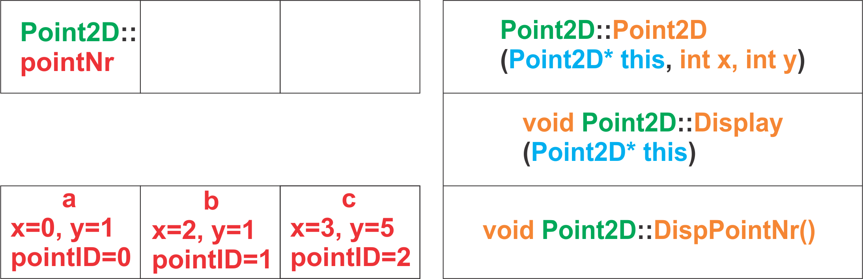
Static Member – detailed, memory view
Example
The global area
The code area
The stack

Slide 29
Static Member – example
Static variable - keep their values and are not destroyed even after they go out of scope
int generateID()
{
static int i = 0;
return i++;
}
int main()
{
cout << generateID(); // prints 0
cout << generateID(); // prints 1
cout << generateID(); // prints 2
return 0;
}

Slide 30
References
http://en.cppreference.com
http://www.cplusplus.com
http://www.learncpp.com
http://www.codeproject.com
http://www.stackoverflow.com
http://www.fredosaurus.com
Video tutorial:
From C++ Tutorial for Beginners 36 – Constructor initialization Lists
To C++ Tutorial for Beginners 52 – Encapsulation

Slide 31
Contact
Published by Siemens 2023
Ionuț Verzea
Software Engineer ADV D EU RO IFA MI
Blv. 15 Noiembrie Nr.78 500097 Brașov România
E-mail ionut.verzea@siemens.com

